Slide 1

CHAPTER 5
SEQUENCES,
MATHEMATICAL
INDUCTION, AND
RECURSION
Copyright © Cengage Learning. All rights reserved.

Slide 2
SECTION 5.2
Mathematical Induction I
Copyright © Cengage Learning. All rights reserved.

Slide 3
Mathematical Induction I
Mathematical induction is one of the more recently developed techniques of proof in the history of mathematics.
It is used to check conjectures about the outcomes of processes that occur repeatedly and according to definite patterns.
In general, mathematical induction is a method for proving that a property defined for integers n is true for all values of n that are greater than or equal to some initial integer.

Slide 4
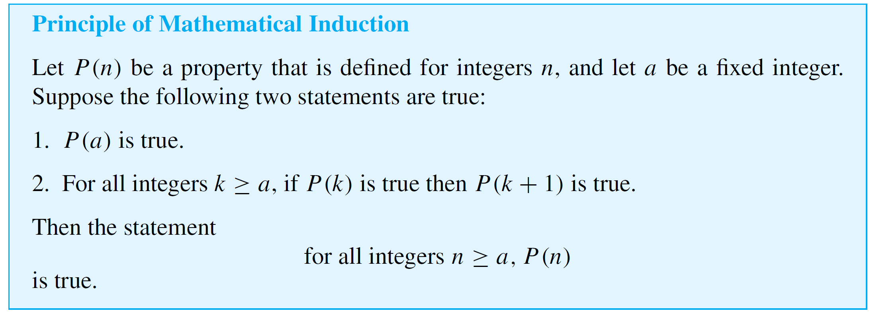
Mathematical Induction I
The validity of proof by mathematical induction is generally taken as an axiom. That is why it is referred to as the principle of mathematical induction rather than as a
theorem.

Slide 5
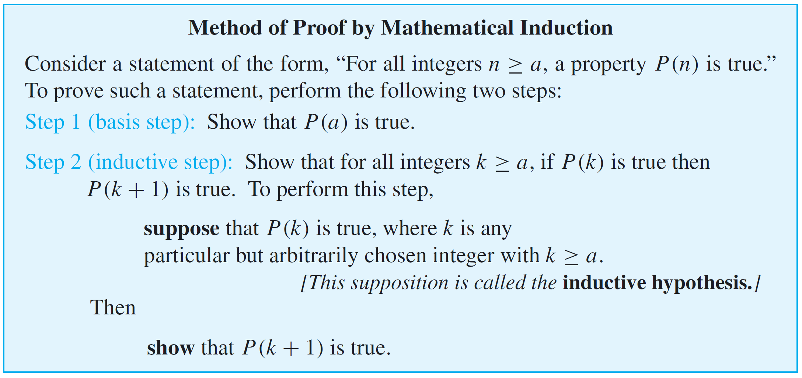
Mathematical Induction I
Proving a statement by mathematical induction is a two-step process. The first step is called the basis step, and the second step is called the inductive step.

Slide 6
Mathematical Induction I
The following example shows how to use mathematical induction to prove a formula for the sum of the first n integers.

Slide 7
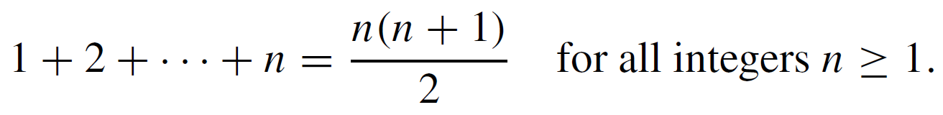
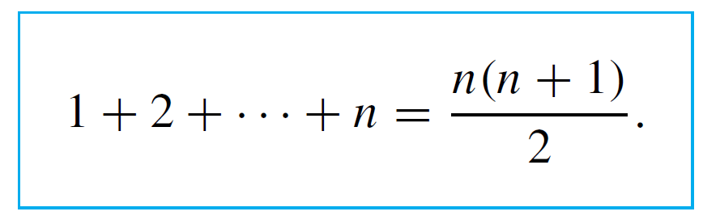

Example 1 – Sum of the First n Integers
Use mathematical induction to prove that
Solution:
To construct a proof by induction, you must first identify the property P(n). In this case, P(n) is the equation
[To see that P(n) is a sentence, note that its subject is “the sum of the integers from 1 to n” and its verb is “equals.”]

Slide 8
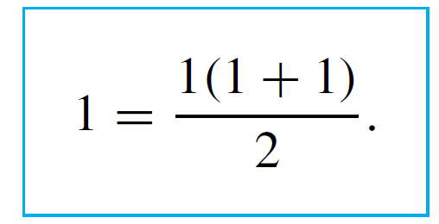

Example 1 – Solution
cont’d
In the basis step of the proof, you must show that the property is true for n = 1, or, in other words that P(1) is true.
Now P(1) is obtained by substituting 1 in place of n in P(n). The left-hand side of P(1) is the sum of all the successive integers starting at 1 and ending at 1. This is just 1. Thus P(1) is

Slide 9
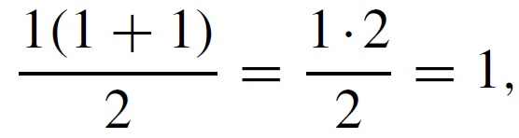
Example 1 – Solution
cont’d
Of course, this equation is true because the right-hand side is
which equals the left-hand side.
In the inductive step, you assume that P(k) is true, for a particular but arbitrarily chosen integer k with k ≥ 1. [This assumption is the inductive hypothesis.]

Slide 10
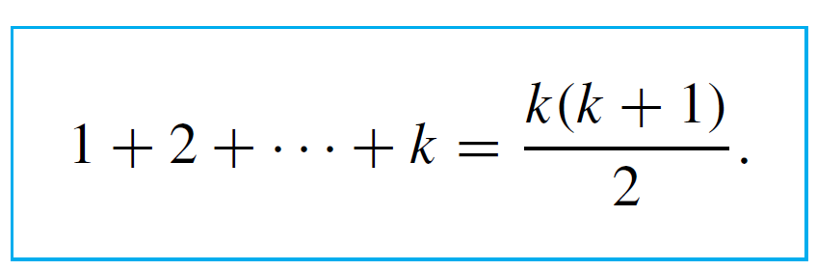

Example 1 – Solution
cont’d
You must then show that P(k + 1) is true. What are P(k) and P(k + 1)? P(k) is obtained by substituting k for every n in P(n).
Thus P(k) is
Similarly, P(k + 1) is obtained by substituting the quantity
(k + 1) for every n that appears in P(n).

Slide 11
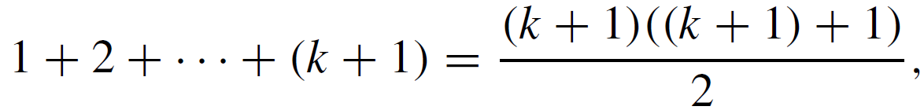
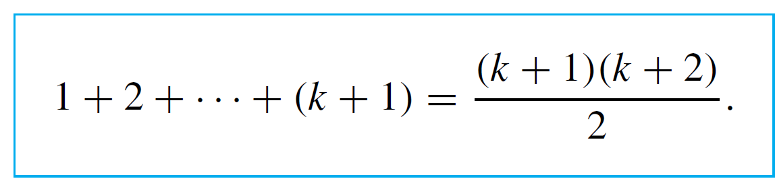

Example 1 – Solution
cont’d
Thus P(k + 1) is
or, equivalently,

Slide 12
Example 1 – Solution
cont’d
Now the inductive hypothesis is the supposition that P(k) is true. How can this supposition be used to show that
P(k + 1) is true? P(k + 1) is an equation, and the truth of an equation can be shown in a variety of ways.
One of the most straightforward is to use the inductive hypothesis along with algebra and other known facts to transform separately the left-hand and right-hand sides until you see that they are the same.

Slide 13
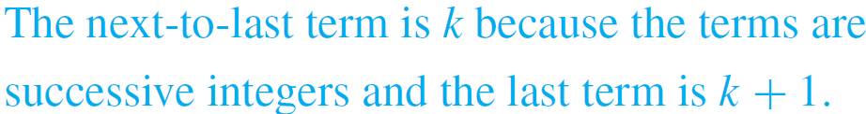

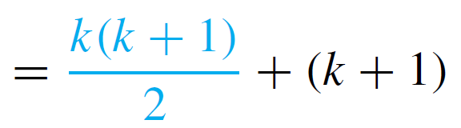
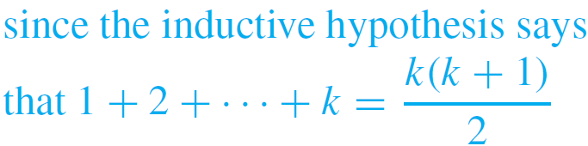
Example 1 – Solution
cont’d
In this case, the left-hand side of P(k + 1) is
1 + 2 +· · ·+ (k + 1),
which equals
(1 + 2 +· · ·+ k) + (k + 1)
But by substitution from the inductive hypothesis,

Slide 14
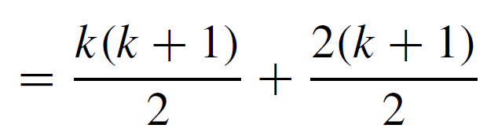
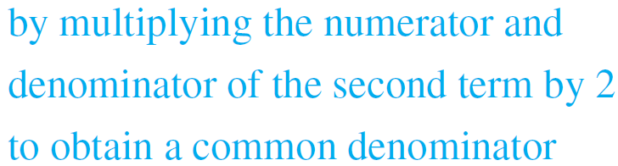
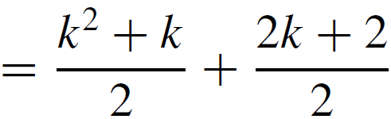

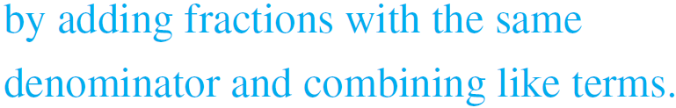
Example 1 – Solution
cont’d

Slide 15
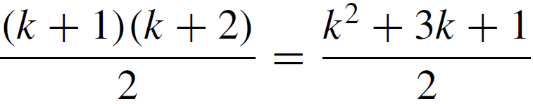
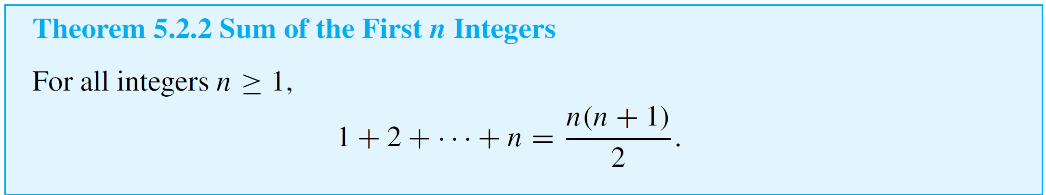
Example 1 – Solution
cont’d
So the left-hand side of P(k + 1) is .
Now the right-hand side of P(k + 1) is
by multiplying out the numerator.
Thus the two sides of P(k + 1) are equal to each other, and so the equation P(k + 1) is true.
This discussion is summarized as follows:

Slide 16
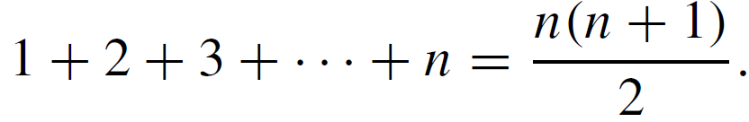

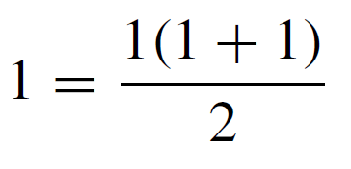

Example 1 – Solution
cont’d
Proof (by mathematical induction):
Let the property P(n) be the equation
Show that P(1) is true:
To establish P(1), we must show that

Slide 17
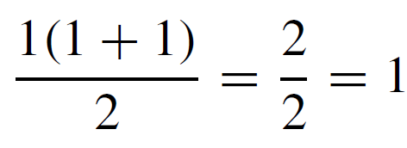
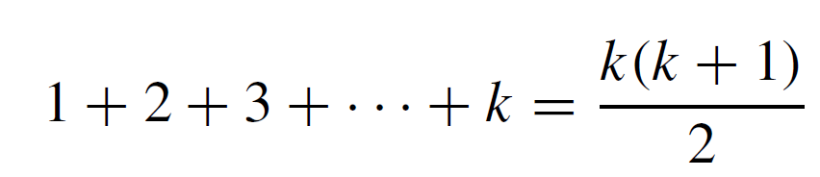
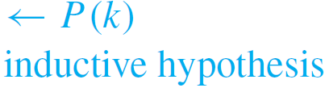
Example 1 – Solution
cont’d
But the left-hand side of this equation is 1 and the right-hand side is
also. Hence P(1) is true.
Show that for all integers k ≥ 1, if P(k) is true then
P(k + 1) is also true:
[Suppose that P(k) is true for a particular but arbitrarily chosen integer k ≥ 1.That is:] Suppose that k is any integer with k ≥ 1 such that

Slide 18
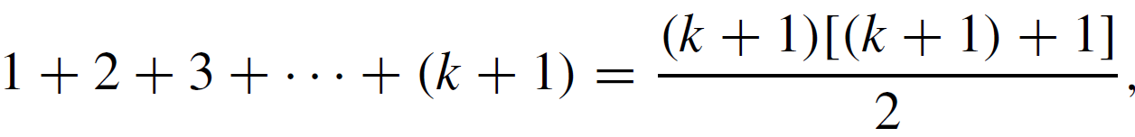
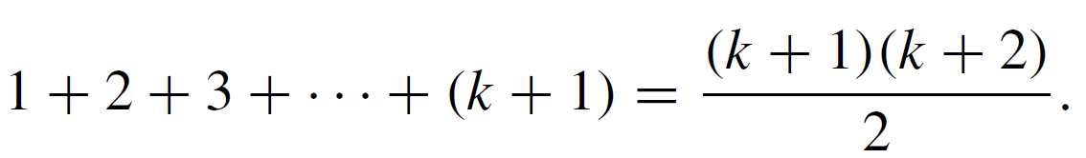

Example 1 – Solution
cont’d
[We must show that P(k + 1) is true. That is:] We must show that
or, equivalently, that
[We will show that the left-hand side and the right-hand side of P(k + 1) are equal to the same quantity and thus are equal to each other.]

Slide 19

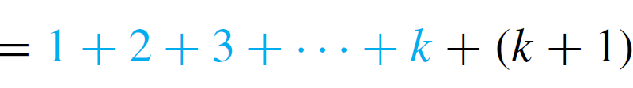
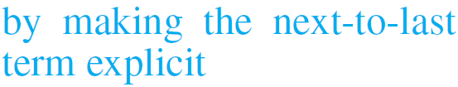
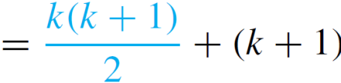
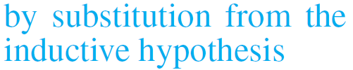
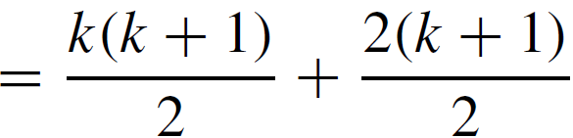
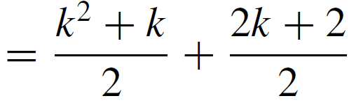
Example 1 – Solution
cont’d
The left-hand side of P(k + 1) is

Slide 20


Example 1 – Solution
cont’d
And the right-hand side of P(k + 1) is

Slide 21
Example 1 – Solution
cont’d
Thus the two sides of P(k + 1) are equal to the same quantity and so they are equal to each other. Therefore the equation P(k + 1) is true [as was to be shown].
[Since we have proved both the basis step and the inductive step, we conclude that the theorem is true.]

Slide 22
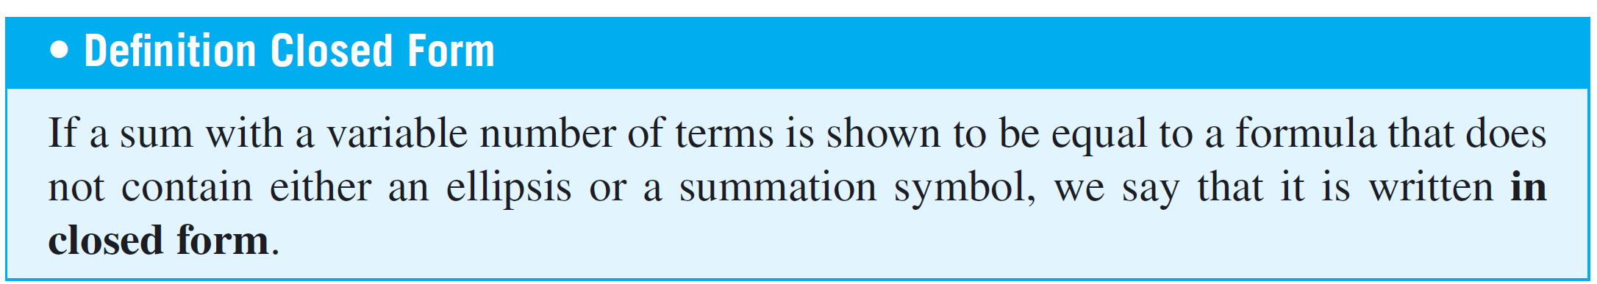
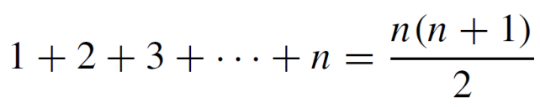
Mathematical Induction I
For example, writing expresses the sum 1 + 2 + 3 +· · ·+ n in closed form.

Slide 23
Example 2 – Applying the Formula for the Sum of the First n Integers
a. Evaluate 2 + 4 + 6 +· · ·+ 500.
b. Evaluate 5 + 6 + 7 + 8 +· · ·+ 50.
c. For an integer h ≥ 2, write 1 + 2 + 3 +· · ·+ (h – 1) in closed form.

Slide 24
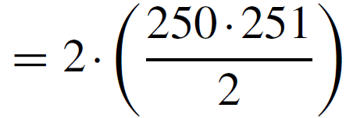


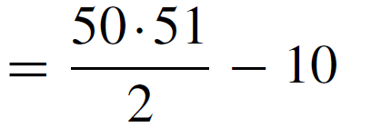


Example 2 – Solution
a.
b.

Slide 25
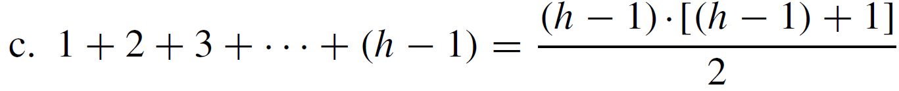
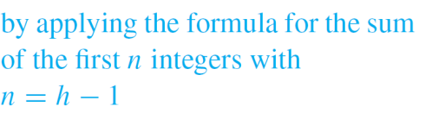
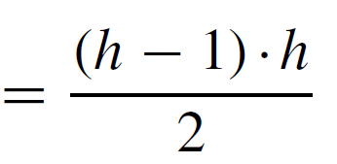

Example 2 – Solution
cont’d
c.

Slide 26
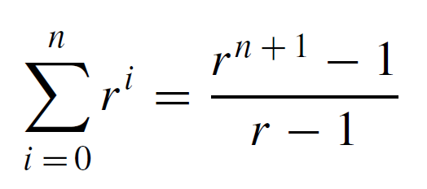
Mathematical Induction I
In a geometric sequence, each term is obtained from the preceding one by multiplying by a constant factor.
If the first term is 1 and the constant factor is r, then the sequence is 1, r, r ², r ³, . . . , r ^{n}, . . . .
The sum of the first n terms of this sequence is given by the formula
for all integers n ≥ 0 and real numbers r not equal to 1.

Slide 27
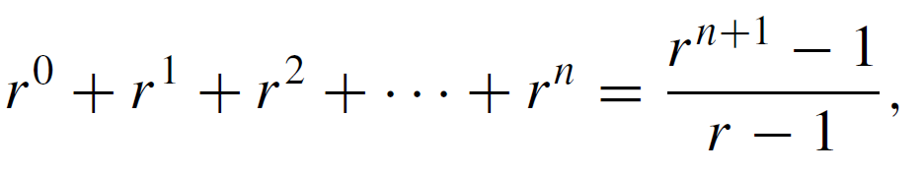
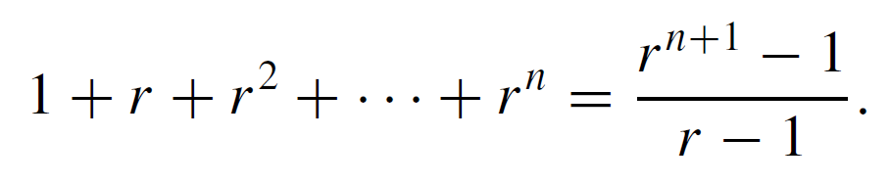
Mathematical Induction I
The expanded form of the formula is
and because r ⁰ = 1 and r ¹ = r, the formula for n ≥ 1 can be rewritten as

Slide 28
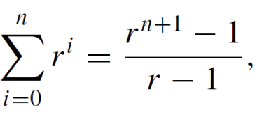
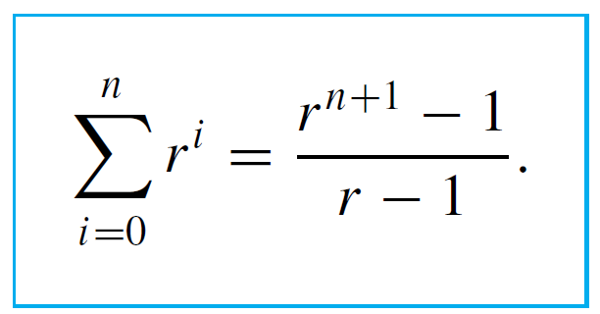

Example 3 – Sum of a Geometric Sequence
Prove that , for all integers n ≥ 0 and all real
numbers r except 1.
Solution:
In this example the property P(n) is again an equation, although in this case it contains a real variable r :

Slide 29
Example 3 – Solution
cont’d
Because r can be any real number other than 1, the proof begins by supposing that r is a particular but arbitrarily chosen real number not equal to 1.
Then the proof continues by mathematical induction on n, starting with n = 0.
In the basis step, you must show that P(0) is true; that is, you show the property is true for n = 0.

Slide 30
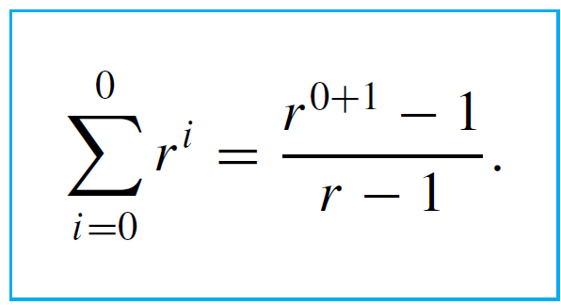

Example 3 – Solution
cont’d
So you substitute 0 for each n in P(n):
In the inductive step, you suppose k is any integer with k ≥ 0 for which P(k) is true; that is, you suppose the property is true for n = k.

Slide 31
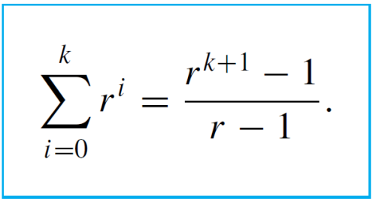

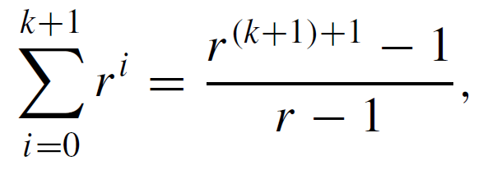
Example 3 – Solution
cont’d
So you substitute k for each n in P(n):
Then you show that P(k + 1) is true; that is, you show the property is true for n = k + 1.
So you substitute k + 1 for each n in P(n):

Slide 32
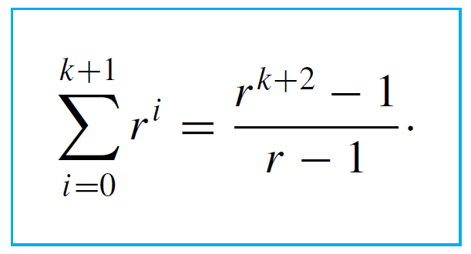

Example 3 – Solution
cont’d
Or, equivalently,
In the inductive step for this proof we use another common technique for showing that an equation is true:
We start with the left-hand side and transform it
step-by-step into the right-hand side using the inductive hypothesis together with algebra and other known facts.

Slide 33
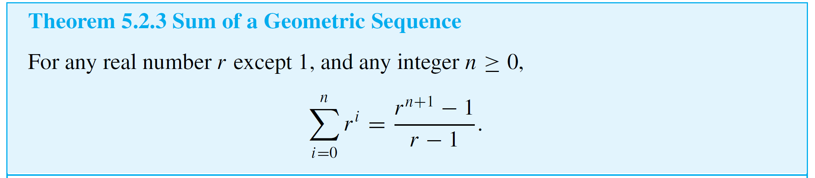
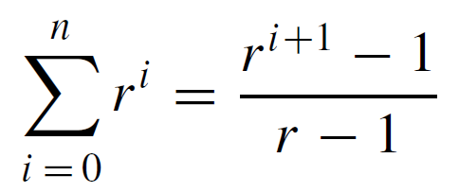

Example 3 – Solution
cont’d
Proof (by mathematical induction):
Suppose r is a particular but arbitrarily chosen real number that is not equal to 1, and let the property P(n) be the equation
We must show that P(n) is true for all integers n ≥ 0. We do this by mathematical induction on n.

Slide 34
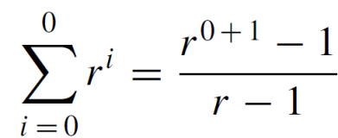


Example 3 – Solution
cont’d
Show that P(0) is true:
To establish P(0), we must show that
The left-hand side of this equation is r ⁰ = 1 and the right-hand side is
also because r ¹ = r and r ≠ 1. Hence P(0) is true.

Slide 35



Example 3 – Solution
cont’d
Show that for all integers k ≥ 0, if P(k) is true then P(k + 1) is also true:
[Suppose that P(k) is true for a particular but arbitrarily chosen integer k ≥ 0. That is:]
Let k be any integer with k ≥ 0, and suppose that
[We must show that P(k + 1) is true. That is:] We must show that

Slide 36






Example 3 – Solution
cont’d
Or, equivalently, that
[We will show that the left-hand side of P(k + 1) equals the right-hand side.] The left-hand side of P(k + 1) is

Slide 37








Example 3 – Solution
cont’d
which is the right-hand side of P(k + 1) [as was to be shown.]
[Since we have proved the basis step and the inductive step, we conclude that the theorem is true.]

Slide 38
Proving an Equality

Slide 39
Proving an Equality
The proofs of the basis and inductive steps in Examples 1 and 3 illustrate two different ways to show that an equation is true:
(1) transforming the left-hand side and the right-hand side independently until they are seen to be equal, and
(2) transforming one side of the equation until it is seen to be the same as the other side of the equation.
Sometimes people use a method that they believe proves equality but that is actually invalid.

Slide 40

Proving an Equality
For example, to prove the basis step for Theorem 5.2.3, they perform the following steps:

Slide 41



Proving an Equality
The problem with this method is that starting from a statement and deducing a true conclusion does not prove that the statement is true.
A true conclusion can also be deduced from a false statement. For instance, the steps below show how to deduce the true conclusion that 1 = 1 from the false statement that 1 = 0:

Slide 42



Proving an Equality
When using mathematical induction to prove formulas, be sure to use a method that avoids invalid reasoning, both for the basis step and for the inductive step.

Slide 43
Deducing Additional Formulas

Slide 44
Deducing Additional Formulas
The formula for the sum of a geometric sequence can be thought of as a family of different formulas in r, one for each real number r except 1.

Slide 45





Example 4 – Applying the Formula for the Sum of a Geometric Sequence
In each of (a) and (b) below, assume that m is an integer that is greater than or equal to 3. Write each of the sums in closed form.
a.
b.
Solution:
a.

Slide 46



Example 4 – Solution
cont’d
b.

Slide 47



Deducing Additional Formulas
As with the formula for the sum of the first n integers, there is a way to think of the formula for the sum of the terms of a geometric sequence that makes it seem simple and intuitive. Let
Then
and so

Slide 48



Deducing Additional Formulas
But
Equating the right-hand sides of equations (5.2.1) and (5.2.2) and dividing by r – 1 gives
This derivation of the formula is attractive and is quite convincing. However, it is not as logically airtight as the proof by mathematical induction.

Slide 49
Deducing Additional Formulas
To go from one step to another in the previous calculations, the argument is made that each term among those indicated by the ellipsis (. . .) has such-and-such an appearance and when these are canceled such-and-such occurs.
But it is impossible actually to see each such term and each such calculation, and so the accuracy of these claims cannot be fully checked.
With mathematical induction it is possible to focus exactly on what happens in the middle of the ellipsis and verify without doubt that the calculations are correct.

